Slide 1
Design and Verification of a Complete Application Specific IC
Members: Julie Swift, Zachary Nelson*,
Dhruvit Naik, Kevin Cao and Whitley Forman
Advisors: Dr. Larry Pearlstein and
Dr. Orlando Hernandez
* Team Leader
Notes:
Zach’s Slide:

Slide 2
Agenda
Project Goals
Detail Specifications
Open Action Items
Project Status:
Schedule
Work Plan/Tasks
Task Details
Budget
Summary
Notes:
Zach’s Slide:
-Detail Specs:
The signals for each block and how the signals will be used
GitHub
-Schedule
Timeline
Weekly Hours per Person
-Work Plan
The tasks that need to be completed to create an IC

Slide 3
Project Goals
Produce a fully functional integrated circuit
Capable of processing audio signals
Implement design on a Field Programmable Gate Array (FPGA)
Allow user to create filter coefficients and upload them to the chip
Parametrize low pass, high pass, band-pass, and comb filters
Provide a BIST (Built In Self Test) function
Notes:
Zach’s Slide:
MOSIS Fabrication Deadline is this November and March
November is not feasible so we are shooting for March
We will get the chip back after graduation
To present our senior project we will also implement our design on a FPGA
Possibly use PSoC microcontroller (slider) to select which type of filter or create a GUI
BIST
Test for a predefined saw-tooth wave just to see if our chip is working correctly

Slide 4
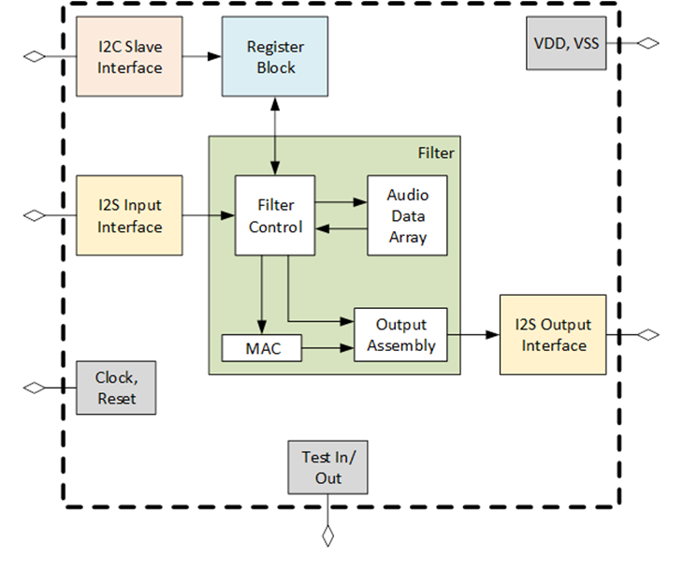
Chip Overview
Notes:
Zach’s Slide:
-5 Major Modules:
I2C Slave Interface (Whitley)
I2S Input Interface (Zach/Kevin)
I2S Output Interface (Kevin)
Filter (Dhruvit)
Register Block (Julie)
-Zach will also be responsible for the top level verilog module called chip.v.
-Explain a basic overview of how the chip is supposed to work:
Analog audio input goes into I2S → goes through filter module → I2S to analog audio output
All module will communicate with register block
I2C is how the system will communicate.

Slide 5
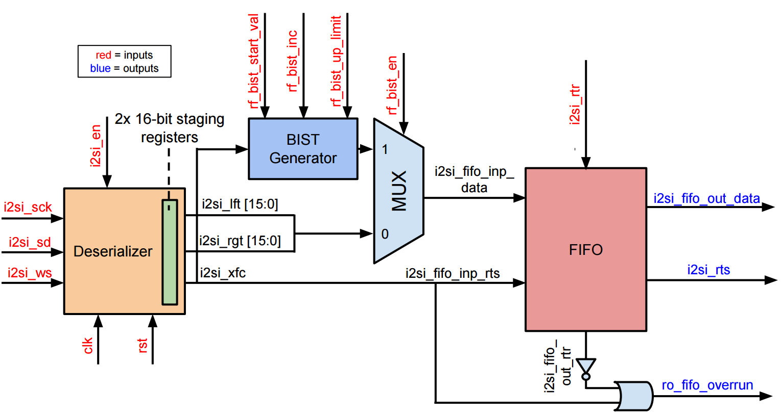
Detail Specifications (I2S In Block Diagram)
Notes:
Zach’s Slide:
Deserializer
clk, rst, isi_en
i2s: sck, sd, ws
staging registers to make it not serialized
outputs either left or right audio depending or ws
BIST Generator
start_val, inc, up_limit
FIFO
Input is either BIST or i2s
FIFO = queue

Slide 6
Detail Specifications (I2S In Interface)
Serial data is transmitted in two’s complement with the MSB first
Support audio input sample rates of 8 kilosamples/sec - 48 kilosamples/sec
Overflow is a possibility because the FIFO buffer could be full when trying to input audio
Subblocks
i2si_bist.gen.v
i2si_fifo.v
i2si_deserializer.v
Notes:
Zach’s Slide:
I2S = Integrated Interchip Sound
-Serial Data
We will follow the I2S standards that were defined by Phillips in 1986
Serial data and clock are separate signals and will first go through a deserializer.
-FIFO
The buffer sizing will have 2 or 3 storage elements which means we need a pointer that is 2 bits.

Slide 7
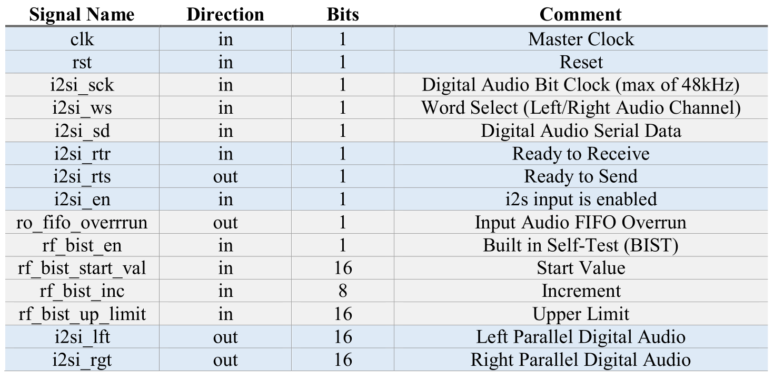
Detail Specifications (I2S In Interface Signals)
Notes:
Zach’s Slide:
-Interface = the inputs and outputs of the i2s In Module
-rf_bist_en
if this bit is true, the BIST audio will be sent to the FIFO

Slide 8
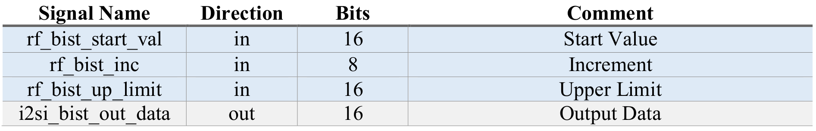
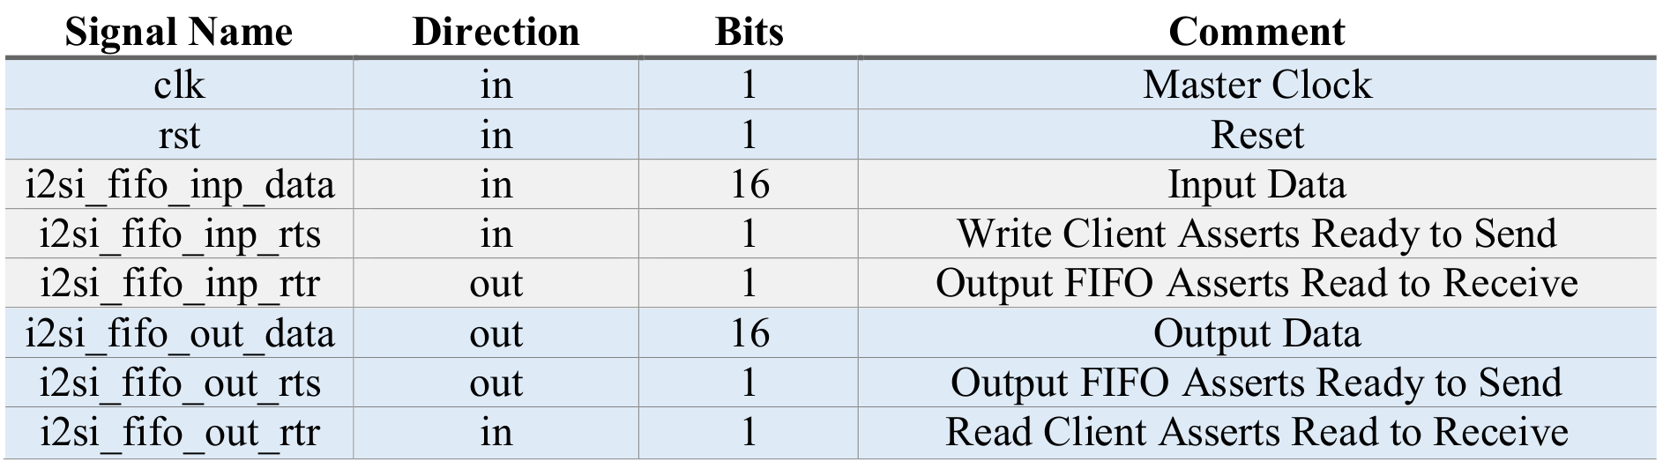
Detail Specifications (I2S In Subblocks)
i2si_bist_gen.v
i2si_fifo.v
Notes:
Zach’s Slide:
BIST
FIFO
fifo_inp_rts = write enabled
fifo_inp_rtr = fifo is NOT full
fifo_out_rts = fifo is NOT empty
fifo_out_rtr = read enabled

Slide 9
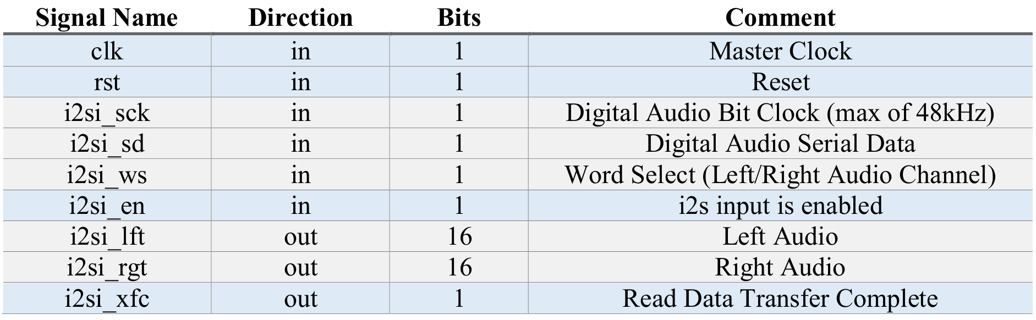
Detail Specifications (I2S In Subblocks)
i2si_deserializer.v
Notes:
Zach’s Slide:

Slide 10
Detail Specifications (I2C Interface)
7-bit serial communication between systems
Transfer of filter coefficients between master (PSoC) and slave (designed chip) to and from specified register addresses
Uses 2 wires for communication and requires 2 external pins on the chip
Works off of a separate clock that is controlled by the master and slave depending on which is sending or acknowledging
Clock runs at 100 kbits/sec or up to 5 mbits/sec
Clock speeds are much lower than that of the system clock so the possibility of overflow is minimal
Address of the chip can be selectable using a dip switch hardware interface (requires more pins) or can be defined to be static by means of manufacturing (no extra pins)
Notes:
Whitley’s Slide:

Slide 11
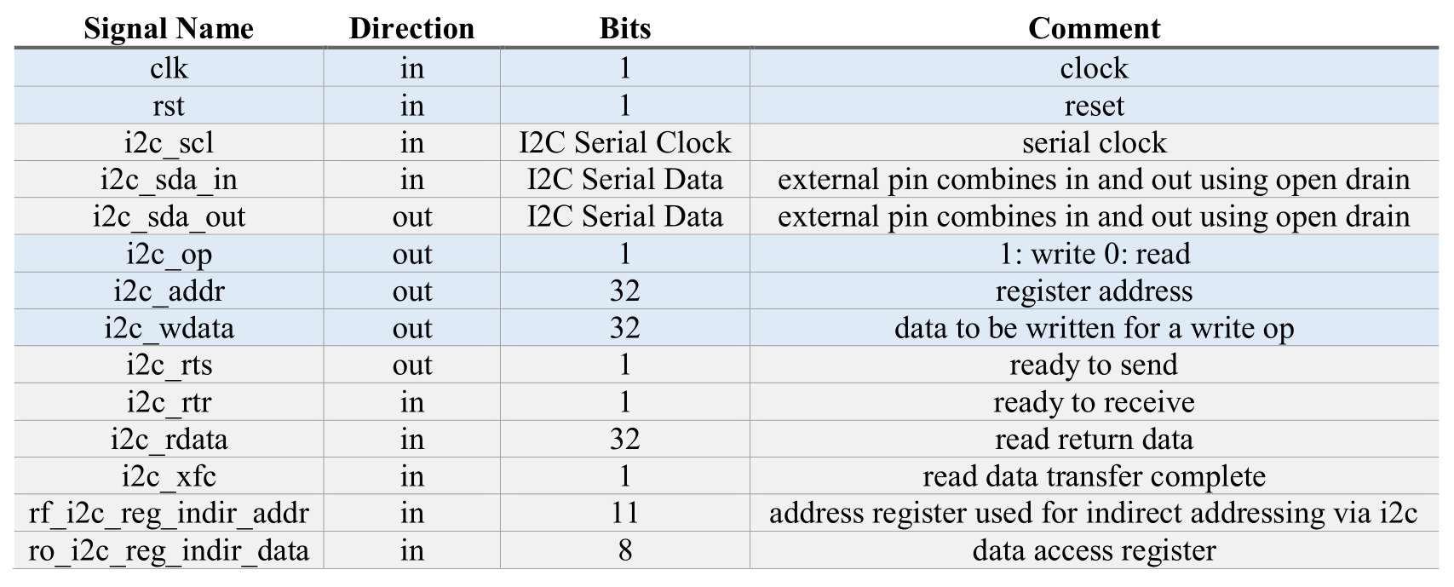
Detail Specifications (I2C Interface External Reg)
Notes:
Whitley

Slide 12
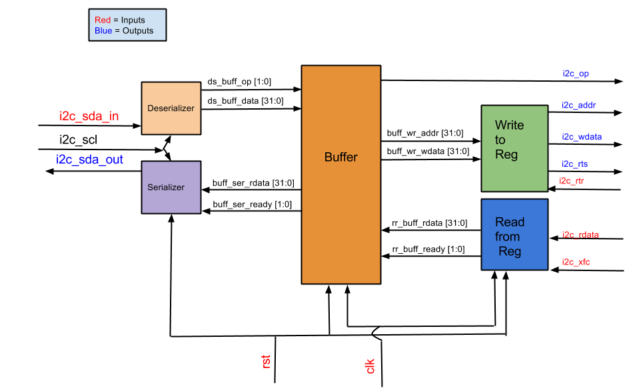
Detail Specifications (I2C Block Diagram)
Notes:
Whitley

Slide 13
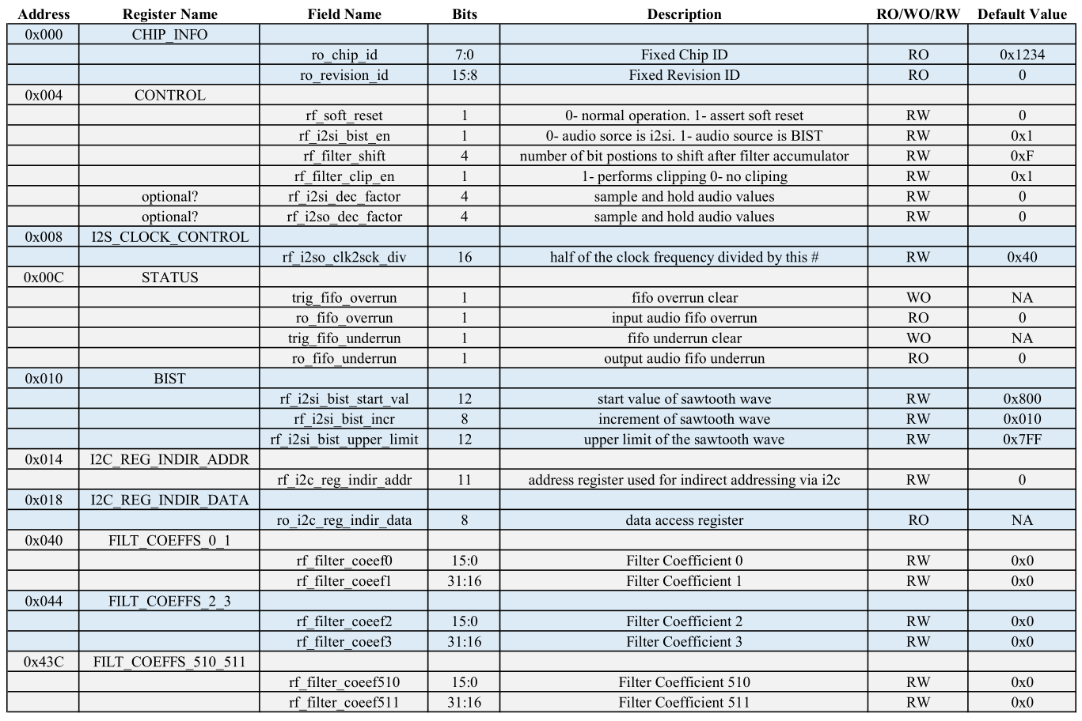
Detail Specifications (Register Block)
Notes:
Julie’s Slide:
Hexadecimal address for each register
Read Only, Write Only, Read/Write
rf-read/write & ro-read only-- infront of the register signals--thats how we know we are getting the signal from the register.
This is our tentative plan of what each of our registers will be assigned to do.
chip information
the control that will be accessing all the modules, as well as the status register
control bits that are on or off will control whether the module is used or not
i2s will be controlling the clock for the i2s module
BIST (built in self test) will be a register address dedicated to i2s’s predefined signal (sawtooth wave)
register dedicated addressing i2c’s usage and data
At the most we will have 256 register addresses dedicated to the 512 filter coeffs.
If we run out of register addresses it would be due to control and status addresses

Slide 14
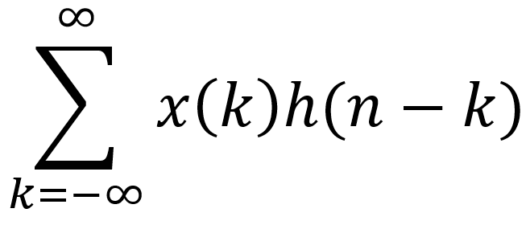
Detail Specifications (Filter)
Both filter_aud_in_lft and filter_aud_in_rgt is transferred from the i2s into a FIFO
rf_filter_coeff# is gathered from the i2c
Data will be accumulated in with a precision of 40 bits
Once ready for output the signal will be rounded, shifted, clipped, and will be returned as a 16 bit value
Notes:
Dhruvit’s Slide:
the filter_aud data is transferred from the i2s at 512 samples in 16 bits
both right and left channels will be processed
the filter coeff will be transferred from the i2c
coeff will be inputted from the i2c
since accumulator is 40 bits, there is a low chance for it to overflow
rounding
barrel shifter -- has the capabilities of shifting any number of bits in a single clock cycle.
clipped -- shift to the portion we want then remove some MSB

Slide 15
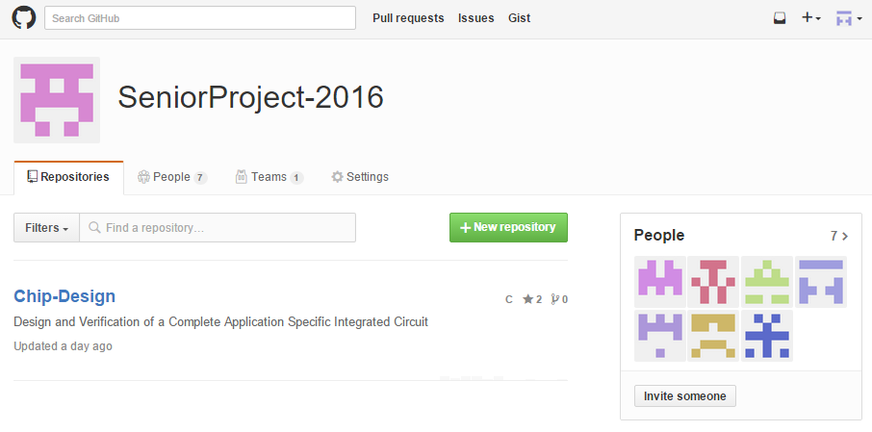
GitHub Revision Control
Notes:
Dhruvit’s Slide:
Instead of dropbox, we will be using github - allowing us to revert to stable builds of our project

Slide 16
GitHub File Hierarchy
rtl (register-transfer level)
chip.v (top level)
i2c_slave.v
i2s_in.v
i2s_out.v
filter.v
register.v
reg (register maps)
synth (synthesis)
dv (design verification)
testbenches
stimulus
scripts
utils (utilities)
docs (documents)
core (CORE 9 files)
Notes:
Dhruvit’s Slide:

Slide 17
Open Action Items
Complete block documents
i2c_slave.v, i2si.v, i2so.v, register.v, and filter.v
RTL design of blocks and subblocks
i2c_slave.v (Whitley)
i2si.v and i2so.v (Zach/Kevin)
i2si_bist_gen.v, i2si_fifo.v, i2si_deserializer.v
register.v (Julie)
filter.v (Dhruvit)
Testing
Notes:
Dhruvit’s Slide
red = not started
green = started/finished
fifo will be used throughout the project - in i2s and filter

Slide 18
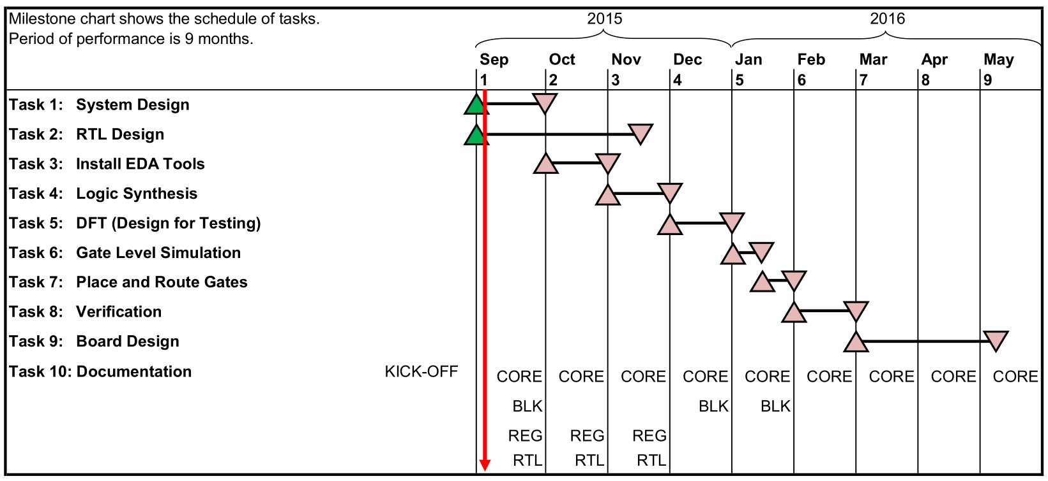
Project Status: Schedule
Notes:
Dhruvit’s Slide:
verification should be finished before we send in code to mosis for manufacturing
when chip is being manufactured we will be designing a BLANK pin board to place the finished chip in for testing
In addition we might develop programs to edit the coefficient values of the chip
red line = now
Documentation
CORE = CORE 9 Stuff
BLK = Update Block Documents
REG = Update Register Address Map
RTL = Update RTL Interface Descriptions

Slide 19
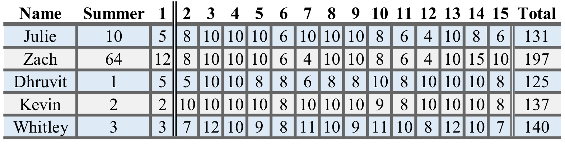
Time Schedule (Hours per Week)
Notes:
Dhruvit’s Slide:

Slide 20
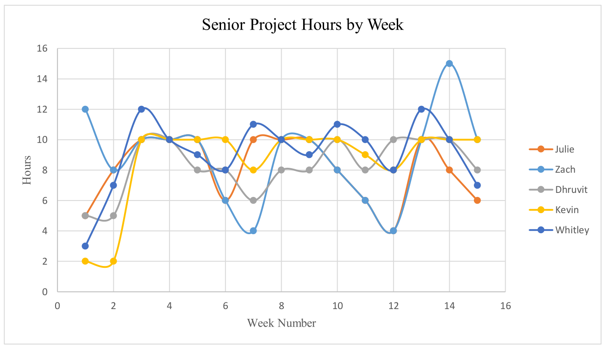
Time Schedule (Hours per Week)
Notes:
Dhruvit’s Slide:

Slide 21
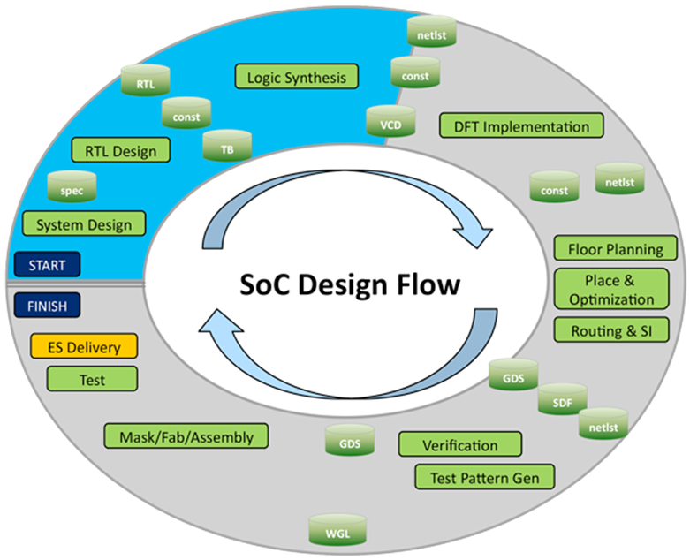
Work Plan:
Notes:
Julie’s Slide:
A general overview of the chip design flow provided by Dr. Pearlstein

Slide 22
Work Plan:
Task 1: System Design
Task 2: RTL Design
Task 3: Install EDA Tools
Task 4: Logic Synthesis
Task 5: DFT (Design for Testing)
Task 6: Gate Level Simulation
Task 7: Place and Route Gates
Task 8: Verification
Task 9: Board Design
Task 10: Documentation
Notes:
Julie’s Slide:
requirements and the design of the chip
(Register Transfer Level) which is everyone's Verilog code and module construction
Installing (Electronic Design Automation Tools) and then
using it for Logic Synthesis
Test insertion and Built In Self Test
checking for x propagation and clock domain issues
placing and routing of our chip on a circuit board
verifying the chip works through a series of tests
designing a circuit board to place the chip on

Slide 23
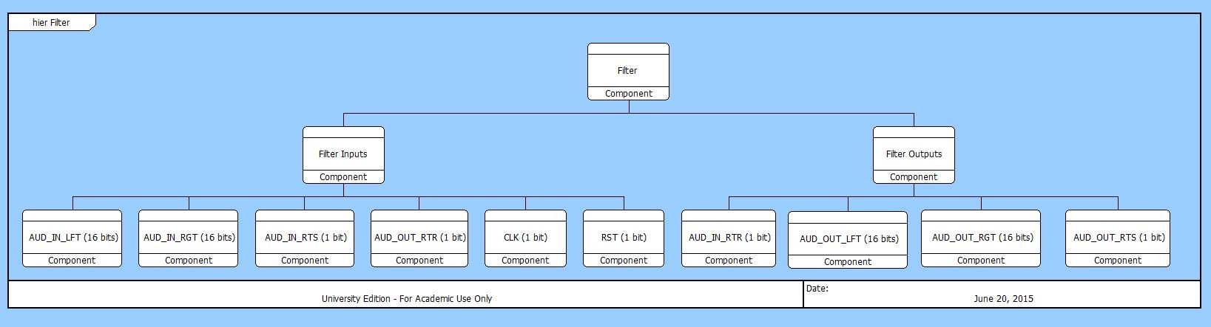
Task 1: System Design
Create block documents for verilog modules
Add information to CORE 9 University
CORE 9 Example
Notes:
Julie’s Slide:
CORE representation to what is

Slide 24
Task 1: System Design (Block Document Layout)
Interfaces
Functional Requirements
Data Plane Requirement
Control Plane Requirements
Control and Status Interface Bit Descriptions
Micro-Architecture
Sub-blocks
Block Diagram
Design
Verification
Notes:
Julie’s Slide: each block will consist of:
Interface signal listing and naming
Data Plane Requirement
What “algorithm” must the block use to produce its outputs?
Control Plane Requirements
Protocols for sending and receiving data
Buffer (aka FIFO) sizing-how much audio the Buffer can hold
How we are going to control the Overflow/underflow possibility of the Buffer
Control and Status Interface Bit Descriptions
Settings control bits
Status bits
Sub-blocks
Verilog modules: i2si, i2so, i2c, regs, filt which will all live under chip.v
Verification- test bench and test plan (describe each test case)

Slide 25
Task 2: RTL Design
Zach: chip.v
Zach/Kevin: i2si.v and i2so.v
i2si_bist_gen.v
i2si_fifo.v
i2si_deserializer.v
Julie: register.v
Whitley: i2c_slave.v
Dhruvit: filter.v
Notes:
Kevin’s Slide:
Sub-blocks are listed for i2si.v not i2so.v

Slide 26
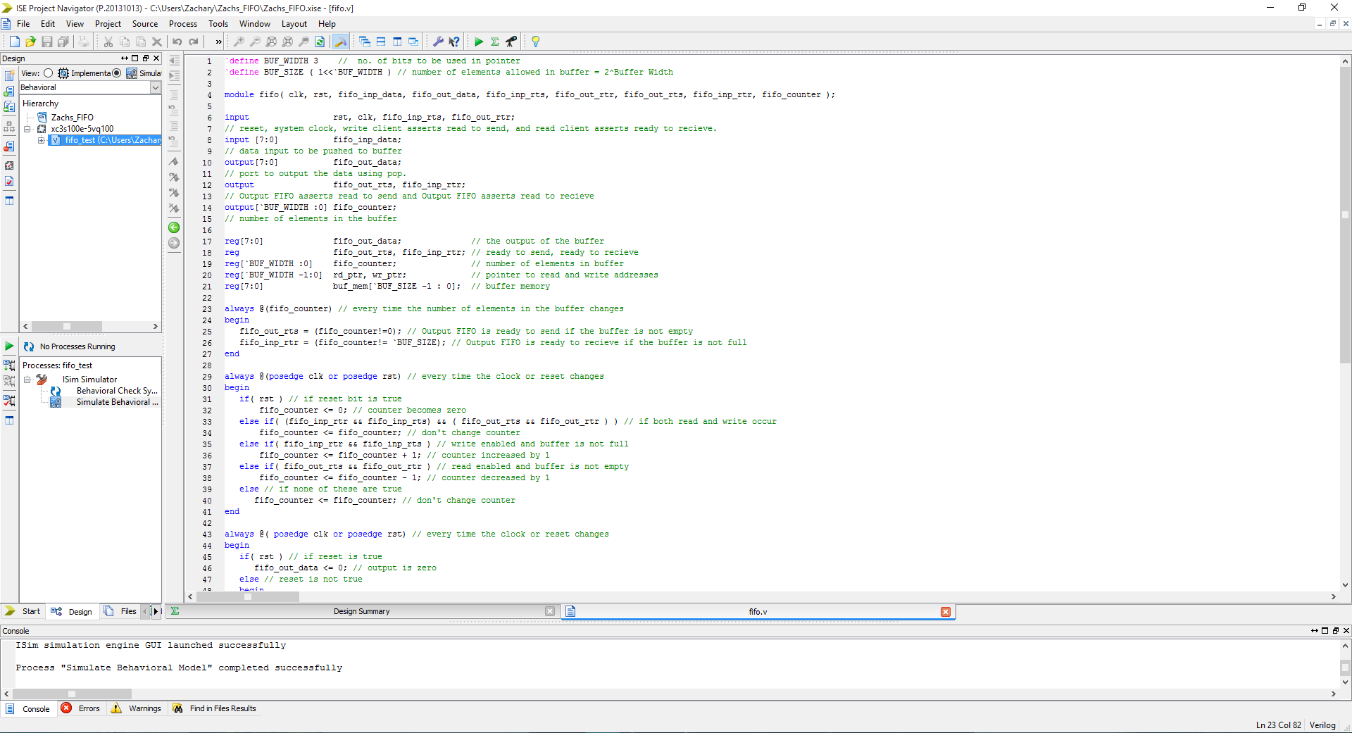
Task 2: RTL Design (i2si_fifo.v)
Notes:
Kevin’s Slide:

Slide 27
Task 3: Install EDA Tools
EDA = Electronic Design Automation
Software tools that engineers use to design integrated circuits
Our team and/or the IT department will be responsible for installing these tools
Top Companies that provide EDA Tools:
Synopsis
Cadence
Mentor Graphics
Notes:
Kevin’s Slide:
https://en.wikipedia.org/wiki/Electronic_design_automation
Still unsure what software tools we are using.
Software may be installed on our personal or school computers. TBD

Slide 28
Task 4: Logic Synthesis
RTL design is turned into a netlist of logic gates
Logic Synthesis is one capability of EDA tools
We will use Xilinx ISE until we get more advanced EDA tools
Static timing analysis
Used to find the timing of the integrated circuit
Clock frequency will be a minimum of 1200 times the audio sampling rate
maximum clock rate will be 100MHz
Notes:
Kevin’s Slide:
https://en.wikipedia.org/wiki/Logic_synthesis
https://en.wikipedia.org/wiki/Static_timing_analysis
Delay calculation must be made during the logic synthesis stage
The main goal of static timing analysis is to verify that all signals will arrive neither too early nor too late, and hence proper circuit operation can be assured.
Integrated circuits are characterized by their clock frequency. Gauging the ability of a circuit to operate at the specified speed requires an ability to measure its delay at numerous steps

Slide 29
Task 5: DFT (Design for Testing)
Test Insertion (Scan Chain)
Replace DFF with scan flops and add scan chain in gates
Modify RTL code
BIST (Built In Self Test)
The BIST will be built into the i2si.v module
The BIST will exist in a submodule called i2si_bist_gen.v
Notes:
Kevin’s Slide:
https://en.wikipedia.org/wiki/Design_for_testing
http://faculty.washington.edu/manisoma/ee540/dft.pdf
DFT: Techniques that add certain testability features to a hardware product design. The added features make it easier to develop and apply manufacturing tests for the designed hardware. The purpose of manufacturing tests is to validate that the product hardware contains no manufacturing defects that could adversely affect the product’s correct functioning.

Slide 30
Task 6: Gate Level Simulation
Reveal startup and reset errors in the logic circuits
Test and reveal any glitches associated with combinational logic, it’s actual delays and the real frequency of the clock
Identify longer than acceptable signal delay path though logic for the frequency
Check for clock domain crossing issues
The transversal of a signal in a synchronous digital circuit from one clock domain into another
Signals may appear asynchronous in incoming clock boundary
Check for X propagation
X describes any unknown log value
2 Issues
X may be converted to a known state by overly optimistic simulation code
gate simulators can generate excess X values because they apply more pessimistic rules
GLS is time and hardware intensive on larger designs, certain blocks need to be identified as being probable of having issues and then run though GLS
Notes:
Whitley's Slide:
https://en.wikipedia.org/wiki/Clock_domain_crossing
http://www.techdesignforums.com/practice/guides/x-propagation/

Slide 31
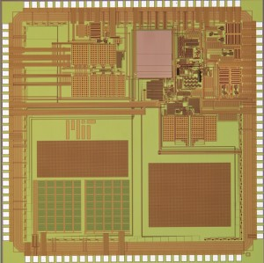
Task 7: Place and Route Gates
Place: place electronic components, circuitry, and logic elements in limited space
(i2s, i2c, register, filter etc.)
Minimize length between high frequency connections
Route: decide design of all wires needed to connect the placed components
Implement desired connections and follow the rules and limitations of the manufacturing process
Most of the routing can be done automatically but may have to be done manually in some instances
Notes:
Whitley's Slide:

Slide 32
Task 8: Verification
Develop a Test Plan (Word/CORE 9)
Develop RTL Test Environment (Verilog, C++)
Test Software (C++)
Test Vectors
Run and Debug RTL Tests
Gate Level Simulation (GLS)
Notes:
Whitley's Slide:

Slide 33
Task 9: Board Design
Hardware test fixture
PSoC5LP as I2C Master
Analog Audio Source
Microcontroller code written to:
Functional test
verify filter coefficients of output
Register test
verify via I2C write and read back
Notes:
Whitley's Slide:

Slide 34
Task 10: Documentation
All documents will be continuously updated and synced with the docs folder on GitHub
Documents include:
Budget
Weekly Time Schedule and Overall Schedule
RTL Interface Descriptions
Register Address Map
Block Documents (5 total)
CORE 9 Project
Meeting Minutes
Diagrams
Notes:
Whitley's Slide:

Slide 35
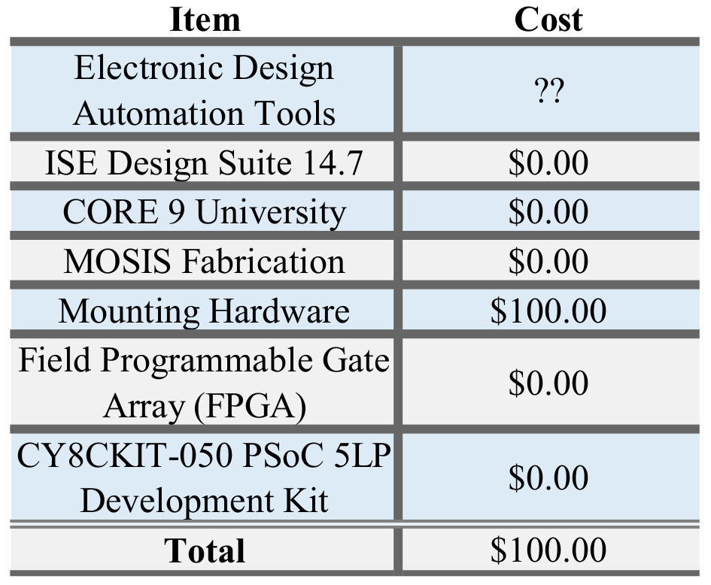
Budget
Notes:
Whitley's Slide:

Slide 36
Summary/Conclusion
First senior project at TCNJ to create an IC
Focus on finishing block documents
Everybody will start participating in RTL design
The chip design must be submitted to MOSIS by March 2016
Receive chip back after graduation
Implement design on FPGA
Notes:
Whitley's Slide:

